Slide 1

Minimization of Power Consumption using LabVIEW
GUIDED BY: BY:
DR.M.MAHESWARI D.AKHIL KRISHNA(15J41A0212)
PROFESSOR & HEAD
EEE DEPARTMENT DEP:ELECTRICAL AND ELECTRONICS
MALLA REDDY ENGINEERING COLLEGE(A)

Slide 2
CONTENTS
Introduction to LabVIEW
Project Introduction
Block Diagram
Time Synchronization
Time VI
Time table
Case Structure for Day sequence
Power Calculations
Appending the data into “Write to Measurement File”
Front panel
Project VI
Conclusion

Slide 3
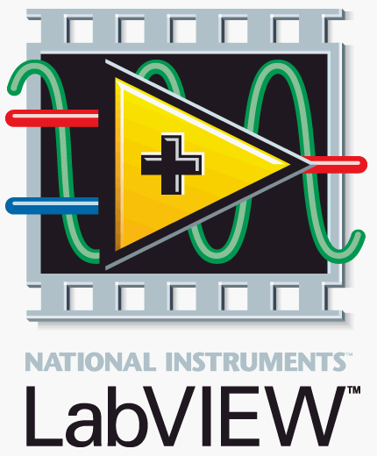
INTRODUCTION TO LabVIEW
LabVIEW (Laboratory Virtual Instrument Engineering Workbench) is a graphical programming environment which has become prevalent throughout research labs, academia and industry.
Its graphical programming language called G programming.
LabVIEW programs are called virtual instruments (VIs), because their
appearance and operation imitate physical instruments like oscilloscopes.
LabVIEW can communicate with hardware such as data acquisition,
vision, and motion control devices.

Slide 4
PROJECT INTRO…..
Main Theme is to obtain Minimization of the POWER Consumption by
taking two Sample Classrooms and two Labs Using LabVIEW.
Time table and Day sequence Case Structure.
Calculating Power
Appending Data into Excel Sheet.
Over Power Consumption Alarms.
ALERT Messages.

Slide 5
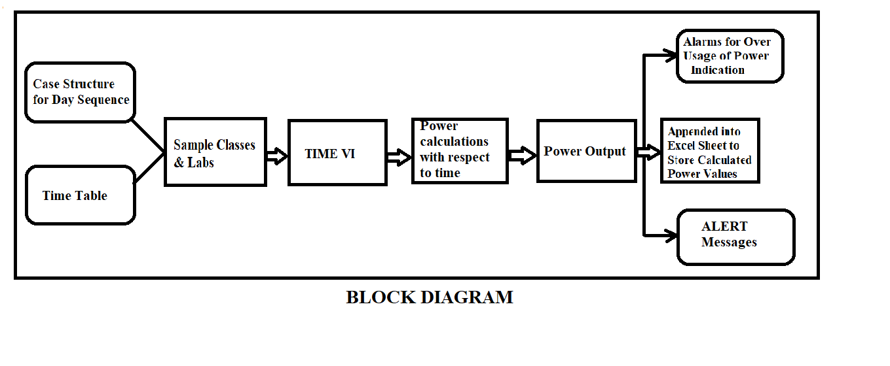
BLOCK DIAGRAM

Slide 6
TIME SYNCHRONISATION
Timing and synchronization technologies correlate events in time, which is necessary to perform coordinated activities.
To Calculate the power at every interval of time.
Store the Power values into Data sheet.
To calculate lapse time of the loads.
It enables the program to sync with date and time of the particular load selected.

Slide 7
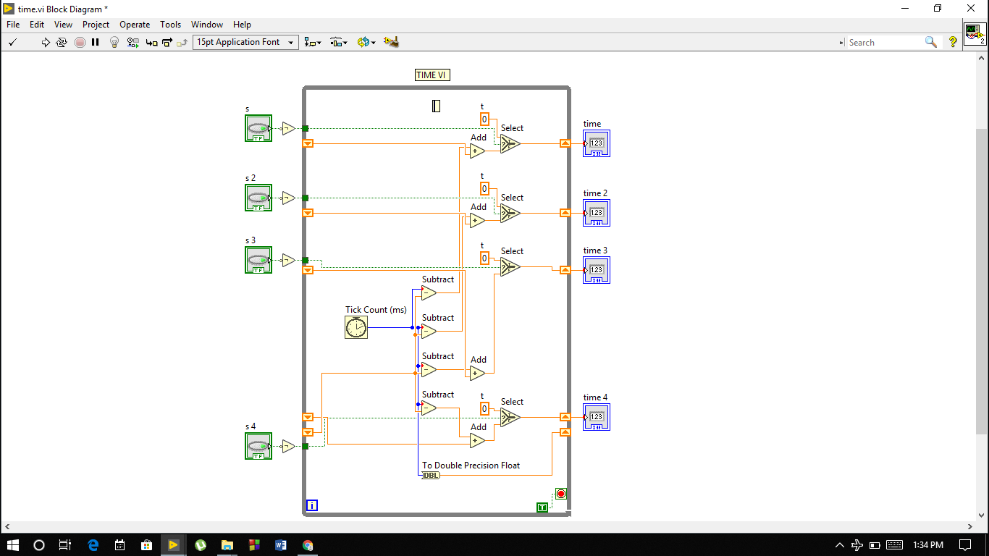
TIME VI

Slide 8
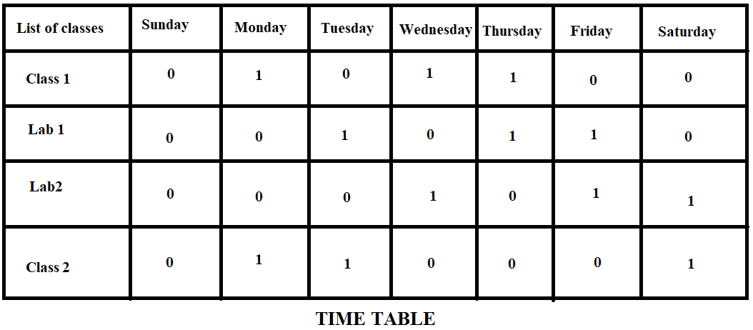
TIME TABLE

Slide 9
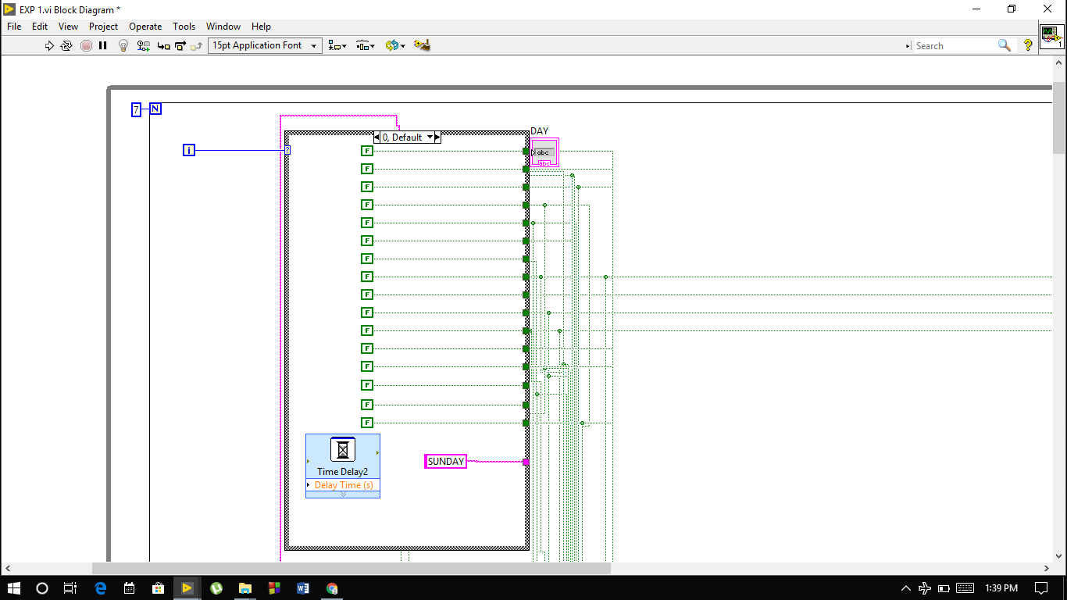
CASE STRUCTURE FOR DAY SEQUENCE

Slide 10
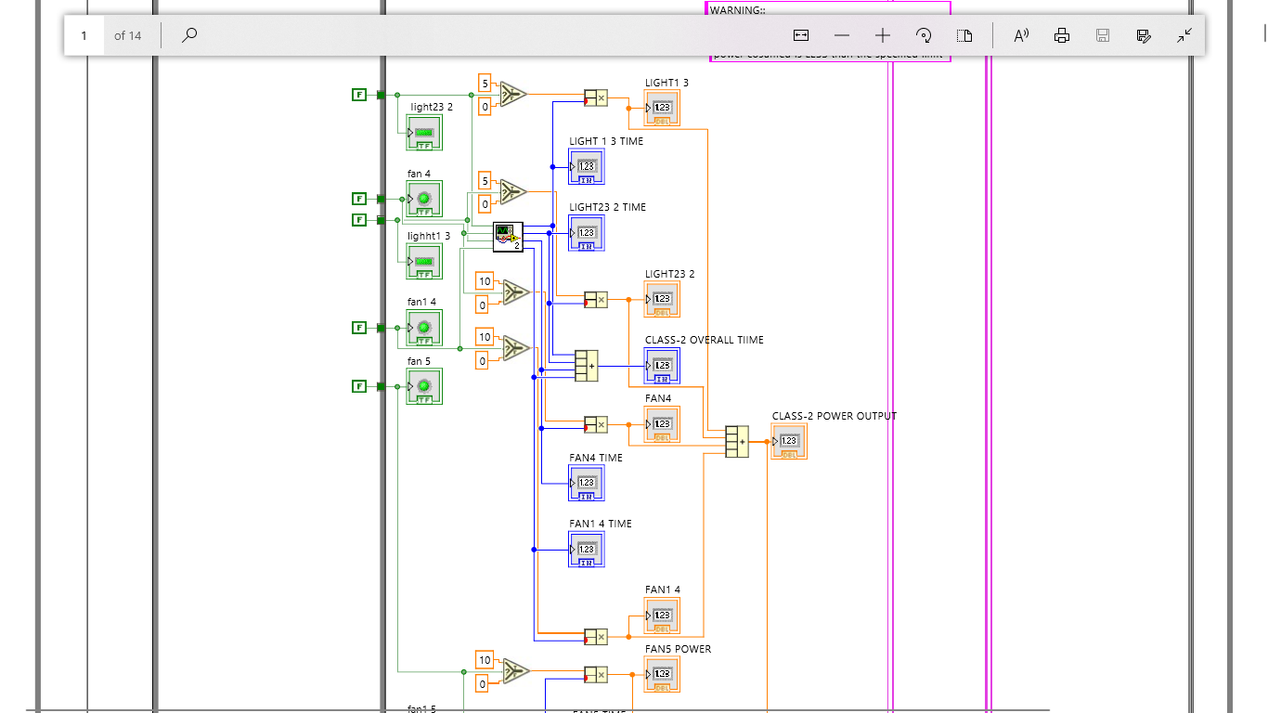
POWER CALCULATIONS

Slide 11
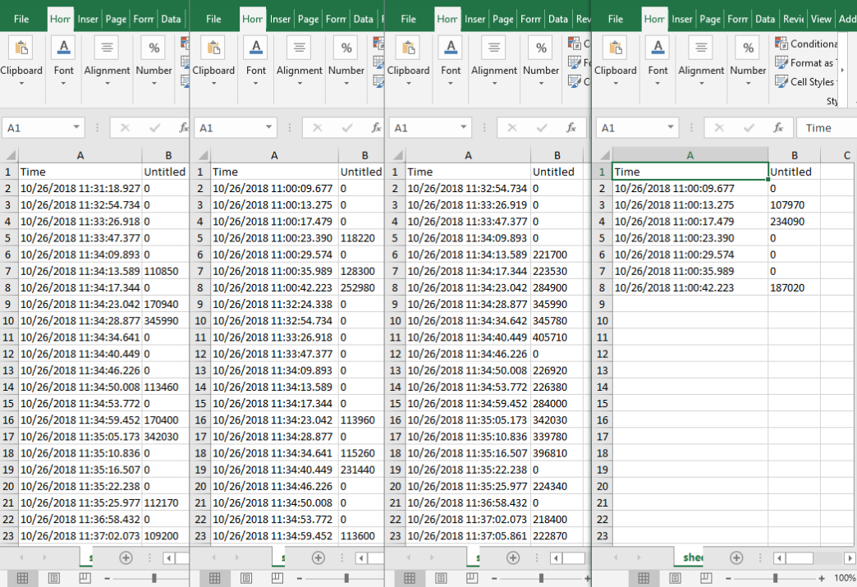
Data Appended to “Write to Measurement File”

Slide 12
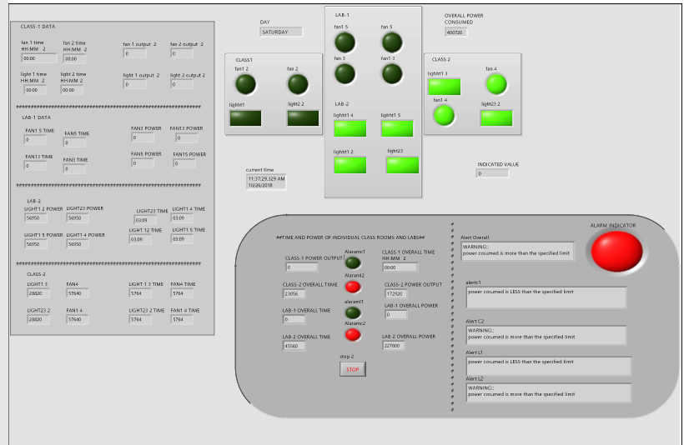
FRONT PANEL

Slide 13
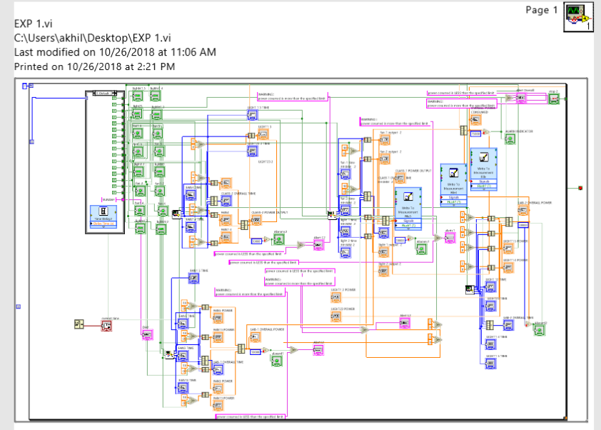
Project VI

Slide 14
Conclusion & Future Scope
Hence by using this method the power consumption is reduced in a smart way.
Once synced with time about 25-30% of extra power consumed is reduced.
This is the best method to conserve the electricity in the industries, institutions & at big infrastructures for commercial use.

Slide 15
Thank you

